Slide 1
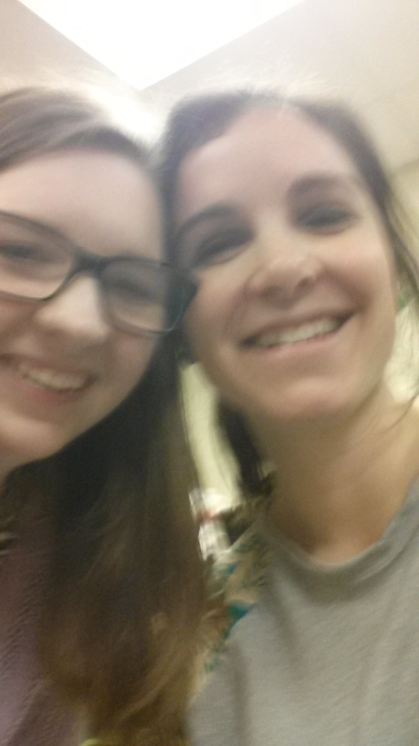
Career Field Experience
By. Natalie Anderson
3rd Hour
9th March, 2016
Supervisor: Ms. Rabbitt

Slide 2
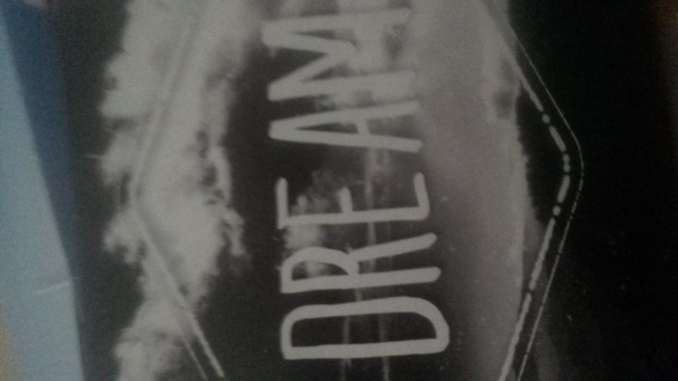
A teacher affects eternity; he can never tell where his influence stops. ~Henry Brooks Adams
What Got Me Interested In Teaching
The potential to leave a lasting impression on the world
Teachers I have had
I enjoy grading
The always changing world of teaching interests me, you never know how each class will react to a lesson
I enjoy building relationships with students and trying to help them because in turn they help me

Slide 3
The Responsibilities of Teaching
Patience
Grading
Planning
Teaching
Encourage Students

Slide 4
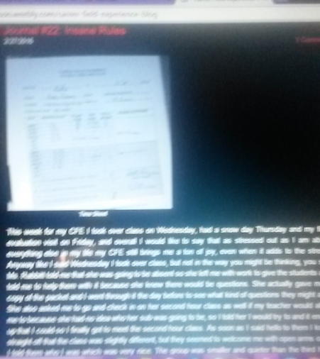
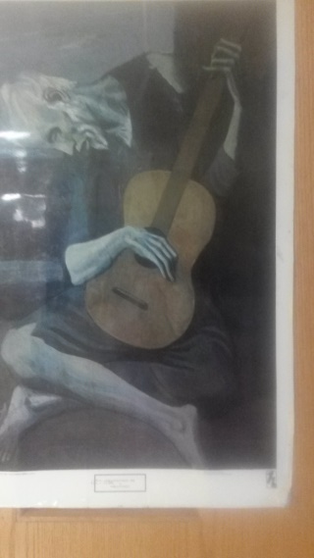
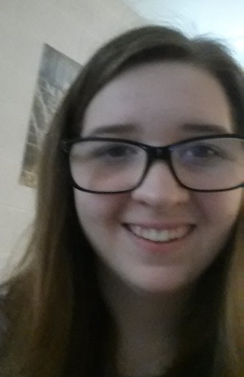
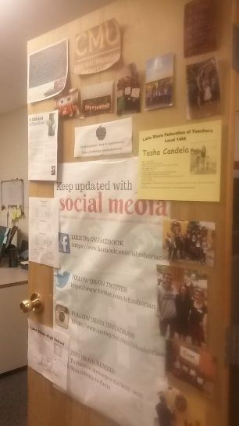
How-To Properly do a CFE Tutorial
Step 1
Step 4
Go to CFE
Experience the CFE and ask questions when you need to
Make sure to check in with Mrs. Candela
Make sure you do a blog post every week and a time sheet every two weeks
Do this for the term and then do the dreaded end of term assignment
Step 2
Step 3
Step 5

Slide 5
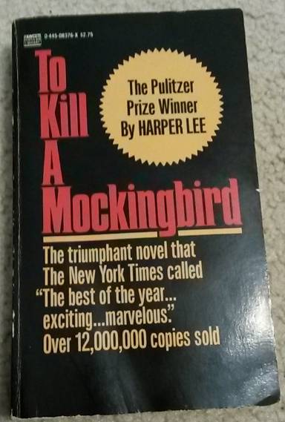
Training, Qualifications and Advancement
I need at least a masters, but I want a doctorate
I plan on going to Macomb Community College then transferring to Central Michigan University
I plan on taking whatever course is available to me for teaching
According to Ms. Rabbitt classes that she thinks will benefit me are
Adolescent Literature
Sociology
Classroom Management

Slide 6
Quote From Employer
Ms. Rabbitts advice for teaching is to, “Build relationships with the students and find out what works for you. The best employees are empathetic with everyone and flexible to what is going on.”
A: Children are very powerful and empathy is as well…empathy is the main theme of To Kill a Mockingbird by Harper Lee.

Slide 7
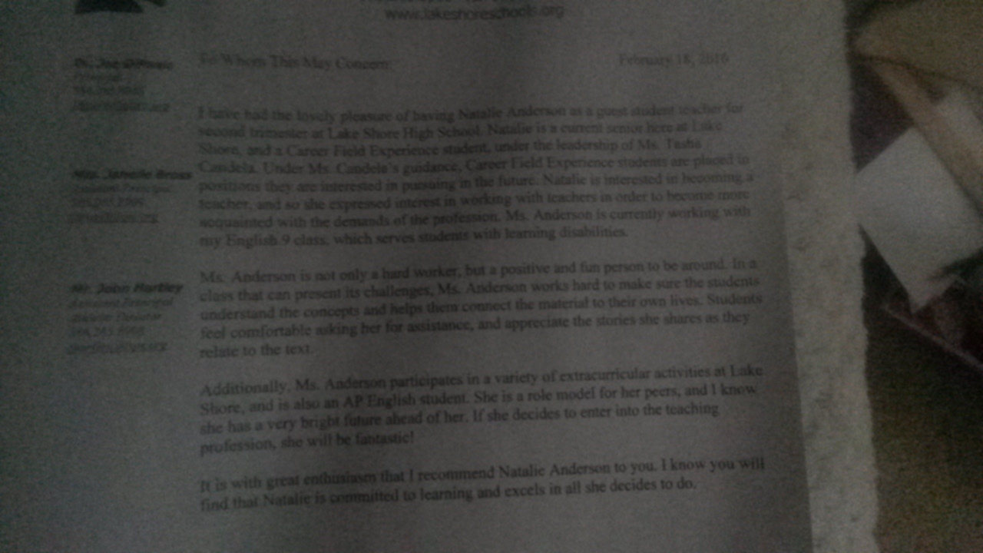
Quote From Letter of Recommendation
Ms. Rabbitt says that I am, “Not only a hard worker, but a positive and fun person to be around.” which has not only nice, but something I didn’t really know. I know I work hard, I just didn’t see how everyone else saw me.

Slide 8
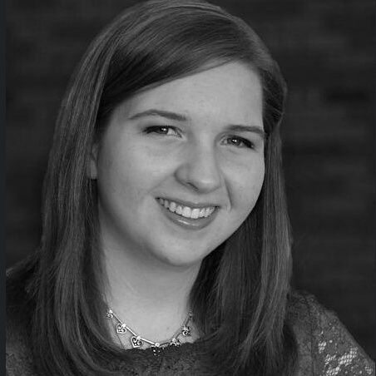
Evaluations
All my evaluation scores were excellent, at least for my first, I don’t know for the second
I still have to work on confidence though
When I asked Ms. Rabbitt about what she thought about the CFE she said that she loved it and how students were not just able to relate to me, but trust me as well
Me trying to be confident

Slide 9
Goal
My goal was to build relationships with the students
Goal=accomplished if you ask me
The students were great and some even trusted me enough to look at their essays
I wouldn’t change a thing about my CFE with Ms. Rabbitt

Slide 10
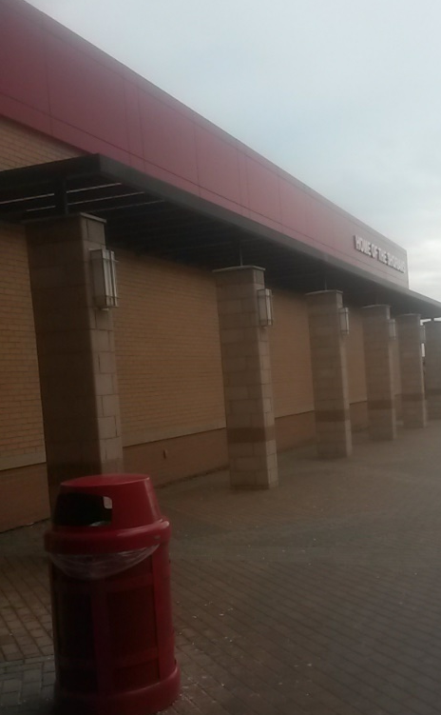
Next Step
My next step after this CFE is to move on to my next CFE and then graduate from high school to hopefully get through college as quickly as possible and to try and get a job as a high school teacher. Who knows maybe I’ll be working at Lake Shore

